Slide 1
Capstone Project Report for The Battle of Neighbourhoods
Locating the best places to have Pizza in USA
Anoop Anto Koonan
Date: 30-July-2020

Slide 2
Introduction
People visiting the US for vacation from various countries make sure that they try to cover a few states in the US during their stay. And when you talk about visiting US, pizza is one of the favourite food people tend to have. And if you can find varieties in pizza people would love that. So, we are going to help these people locate the best places to have pizza and at the same time help them to find places where they can try different varieties of pizza.

Slide 3
Data Section
I will be using the Foursquare API to collect data about locations of Pizza stores from 5 major US cities which are: New York, NY, San Francisco, CA, Jersey City, NJ, Boston, MA and Chicago, IL. Considering these to be one of the most populated US cities, I am hopeful that these locations will have lots of pizza stores and different varieties of pizzas to be savoured.

Slide 4
Methodology
My main target here was to assess which city would have the highest Pizza store density.
For that I used the Foursquare API through the venues channel.
I used the near query to get venues in the cities.
I use the Category ID to set it to show only Pizza Places.
An Example of my requests:
https://api.foursquare.com/v2/venues/explore?&client_id=&client_secret=&v=20180605&New York, NY&limit=100&categoryId=4bf58dd8d48988d1ca941735
(4bf58dd8d48988d1ca941735 is the Id of the Pizza Place Category. Also, Foursquare limits us to maximum of 100 venues per query)

Slide 5
Methodology - Continued
I repeated this request for the 5 cities and got their top 100 venues.
I saved the name and coordinate data only from the result and plotted them on the map for visual inspection.
To get an indicator of the density of Pizza Places, I calculated a centre coordinate of the venues to get the mean longitude and latitude values.
I, then calculated the mean of the Euclidean distance from each venue to the mean coordinates. That was my indicator; mean distance to the mean coordinate.

Slide 6
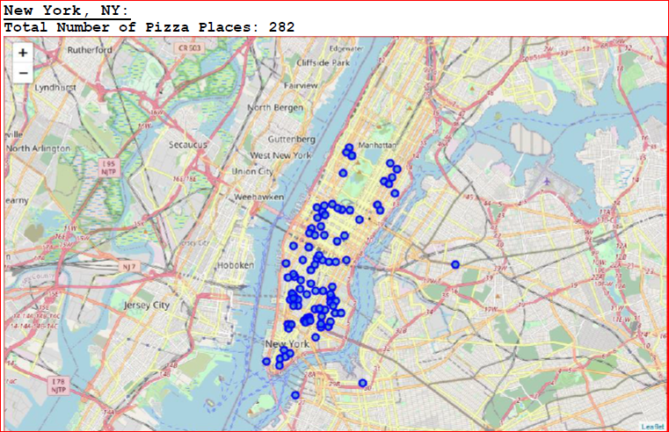
result
For our initial visual inspection, we see that they all have multiple pizza places and often more than Foursquare would like to supply us. The following here are the pictures of the geoplot generated with folium:

Slide 7
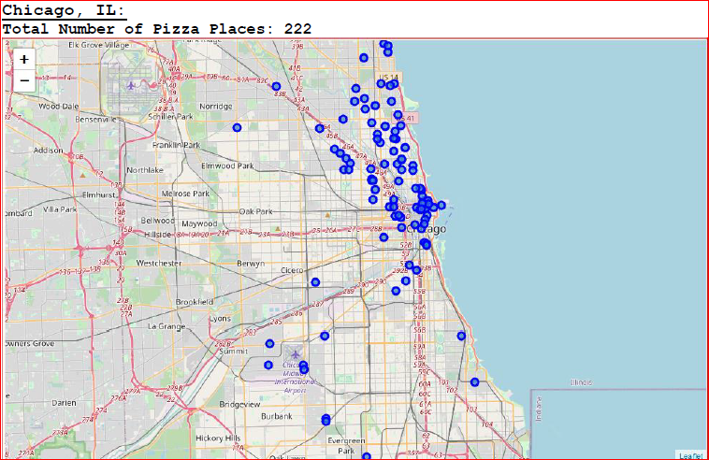
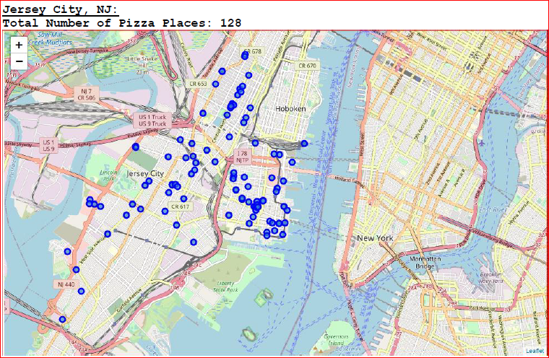
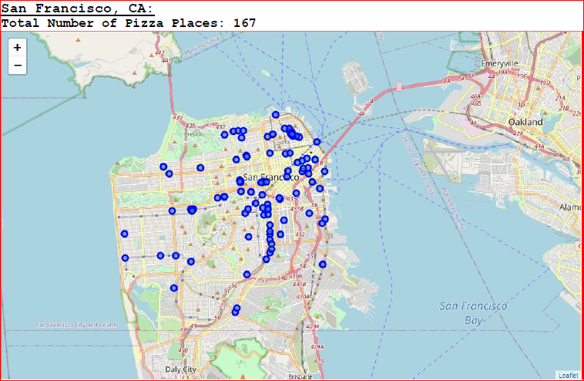
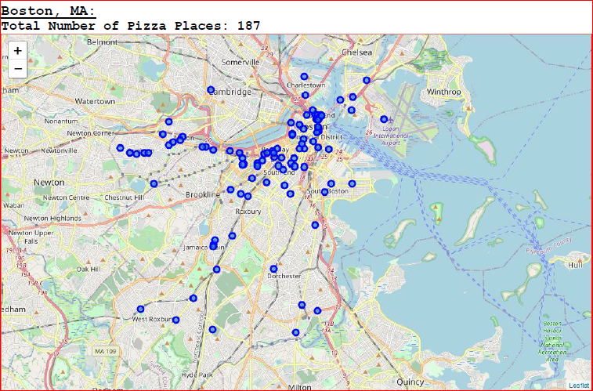

Slide 8
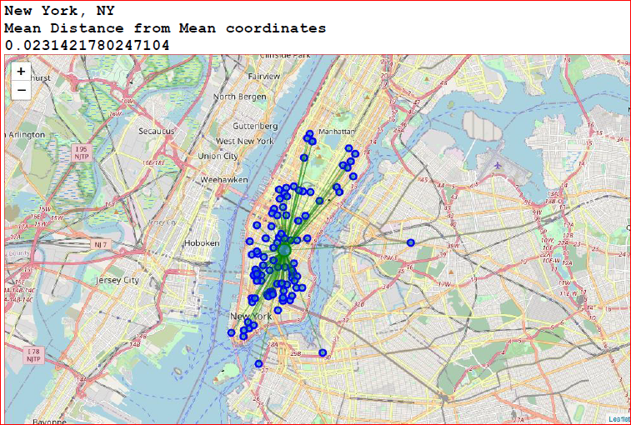
Result - continued
Upon First inspection we see that New York, Jersey City and San Francisco are the most densely cities. In the next phase, we Calculate the Mean coordinate and the mean distance to mean coordinate(MDMC). We represent the mean coordinate with a big green circle and distances with green lines

Slide 9
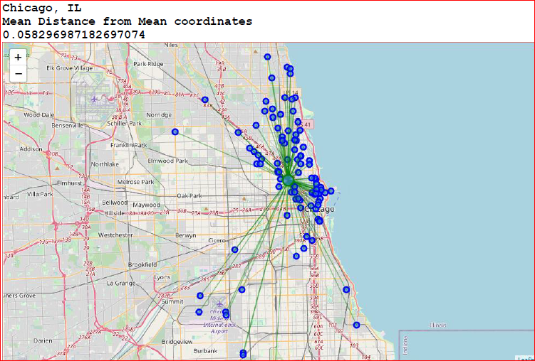
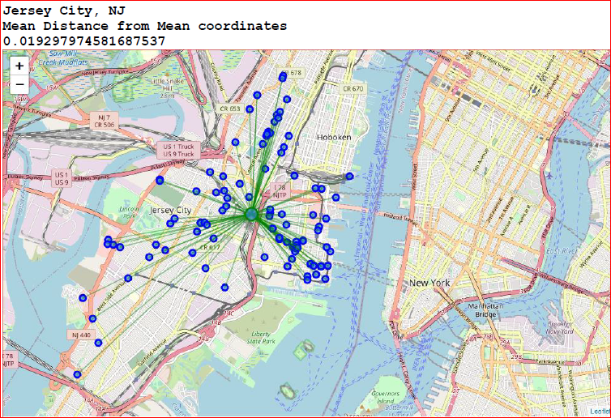
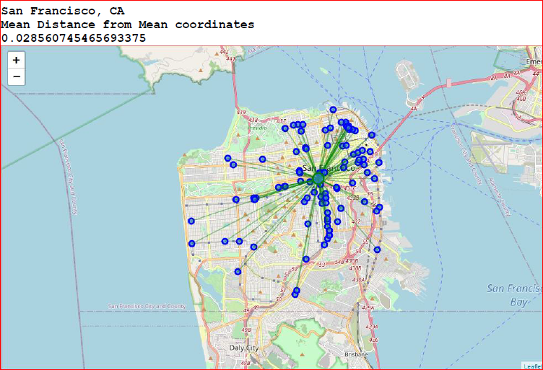
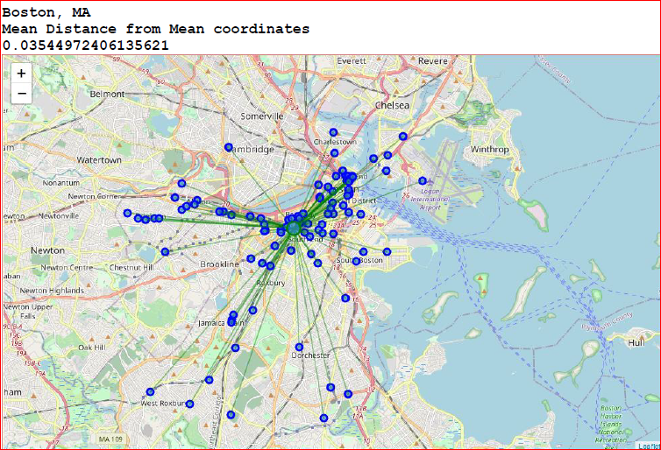

Slide 10
Discussion
From the maps above I would suggest a visitor to visit New York first as he can visit NYC and Jersey City together as these places are nearby each other, just a shore apart and thereby making the total count of the pizza places to be 282+128=410. There are a lot of attraction that you can cover at these two places and at the same time enjoy large varieties of pizzas when you are hungry.
After covering New York, if the visitors still have time in their vacation time, my recommendation would be to travel to Boston, MA, Chicago, IL and San Francisco, CA respectively. They can enjoy the various attractions at these places and can savour the different types of pizza because of our help now.

Slide 11
Conclusion
We can conclude that New York is the best option for a Pizza lover to start his vacation time in the US as it has more pizza places. A visitor's best option is to book a hotel near the mean coordinate to surround himself with 100s of Pizza places !!

Slide 12
Thank you

